Slide 1
WORLD RANKING UNIVERSITY
MULTIPLE REGRESSION

Slide 2
Of all the universities in the world, which are the best?
Ranking universities is a difficult, political, and controversial practice. There are hundreds of different national and international university ranking systems, many of which disagree with each other. This dataset contains three global university rankings from very different places.

Slide 3
Dependent variable - world_rank (VARIBLE TO PREDICT)
Independent variable –
national_rank
quality_of_education
alumni_employment
quality_of_faculty
publications
influence
citations
broad_impact
patents score

Slide 4
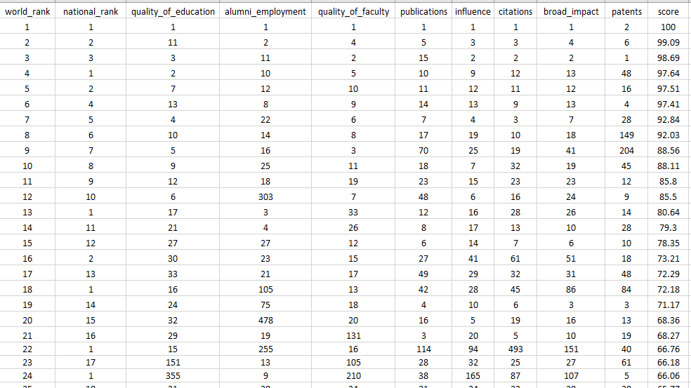
SNIPPET OF THE DATA Dataset: https://www.kaggle.com/mylesoneill/world-university-rankings

Slide 5
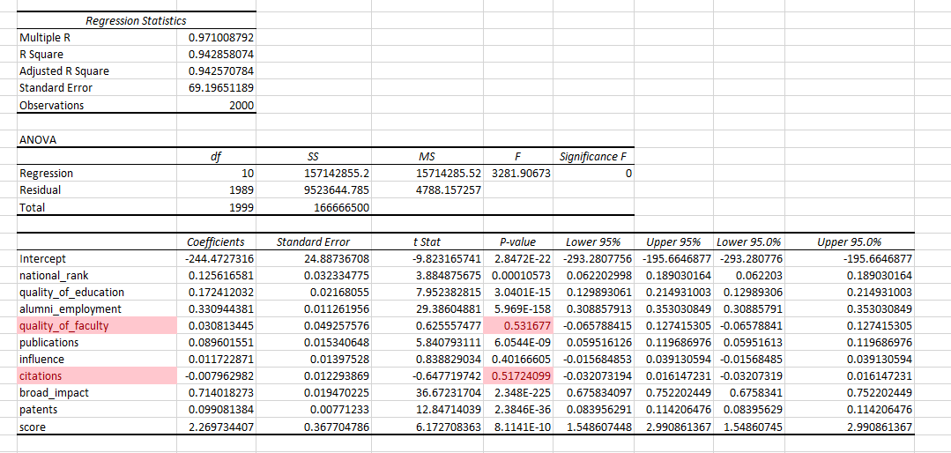
MULTIPLE REGRESSION

Slide 6
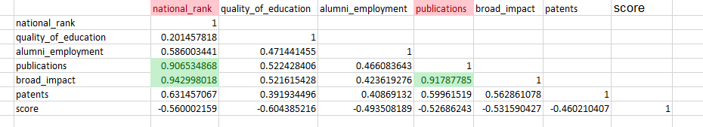
X VS X - COLINEARTY

Slide 7
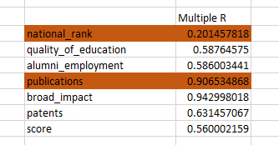
DELETE IF SMALLER MULTIPLE R

Slide 8
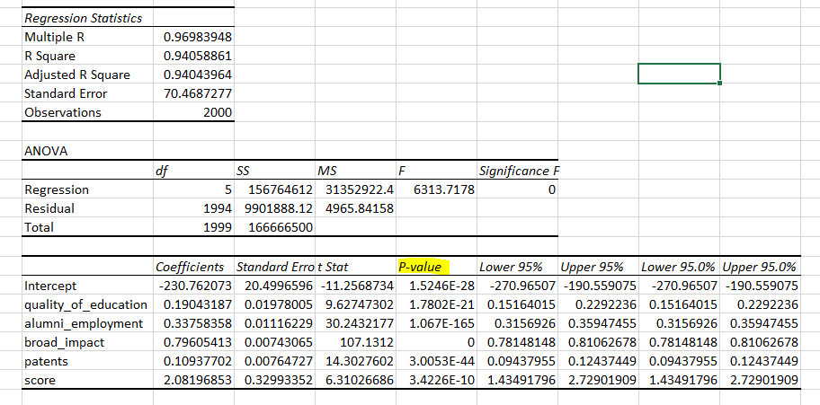
MULTIPLE REGRESSION – AFTER COLINEARTY

Slide 9
WORLD_RANKING EQUATION : y=B0 + B1*X1 + B2*X2+…..
y = -230.7620727 + 0.190431872*quality_of_education + 0.337583577*alumni_employment + 0.79605413*broad_impact + 0.10937702*patents + 2.081968528*score
Notes:
Conclusion: Word rank can be predict using this remaining X with the Y (Word Rank):

